Slide 1
UBGC STUDENT PORTAL
Jay Figueroa
CST 499

Slide 2


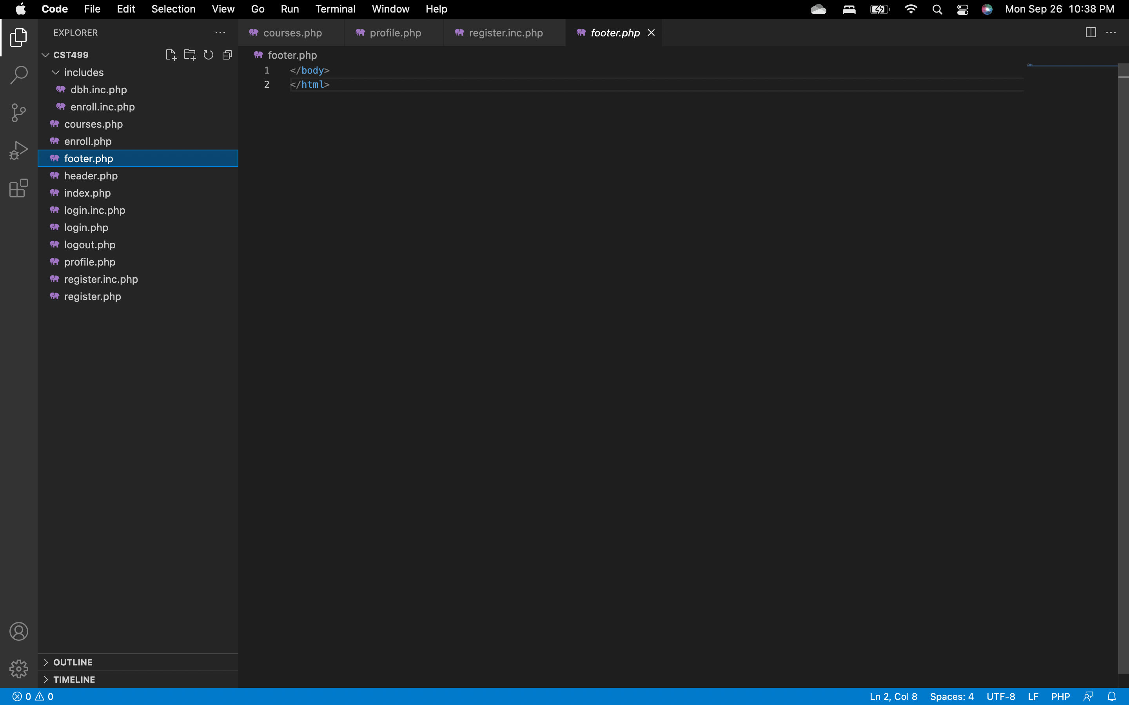

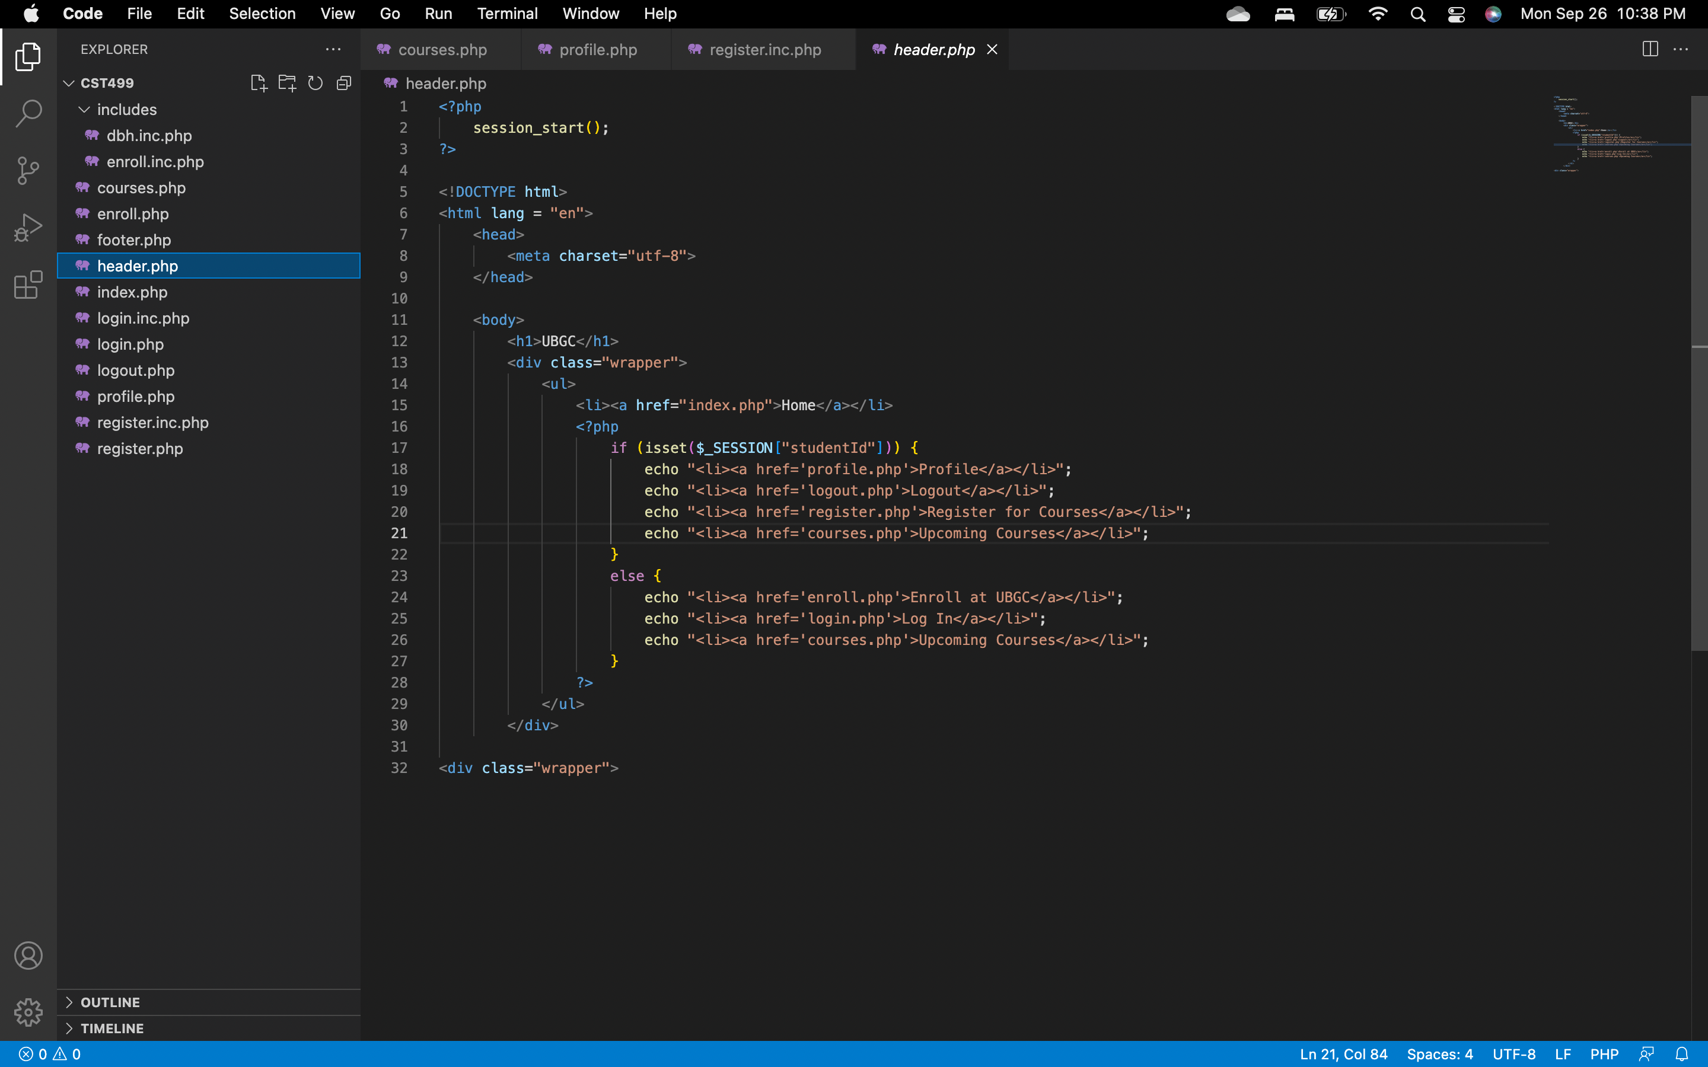
Header/Footer
z

Slide 3
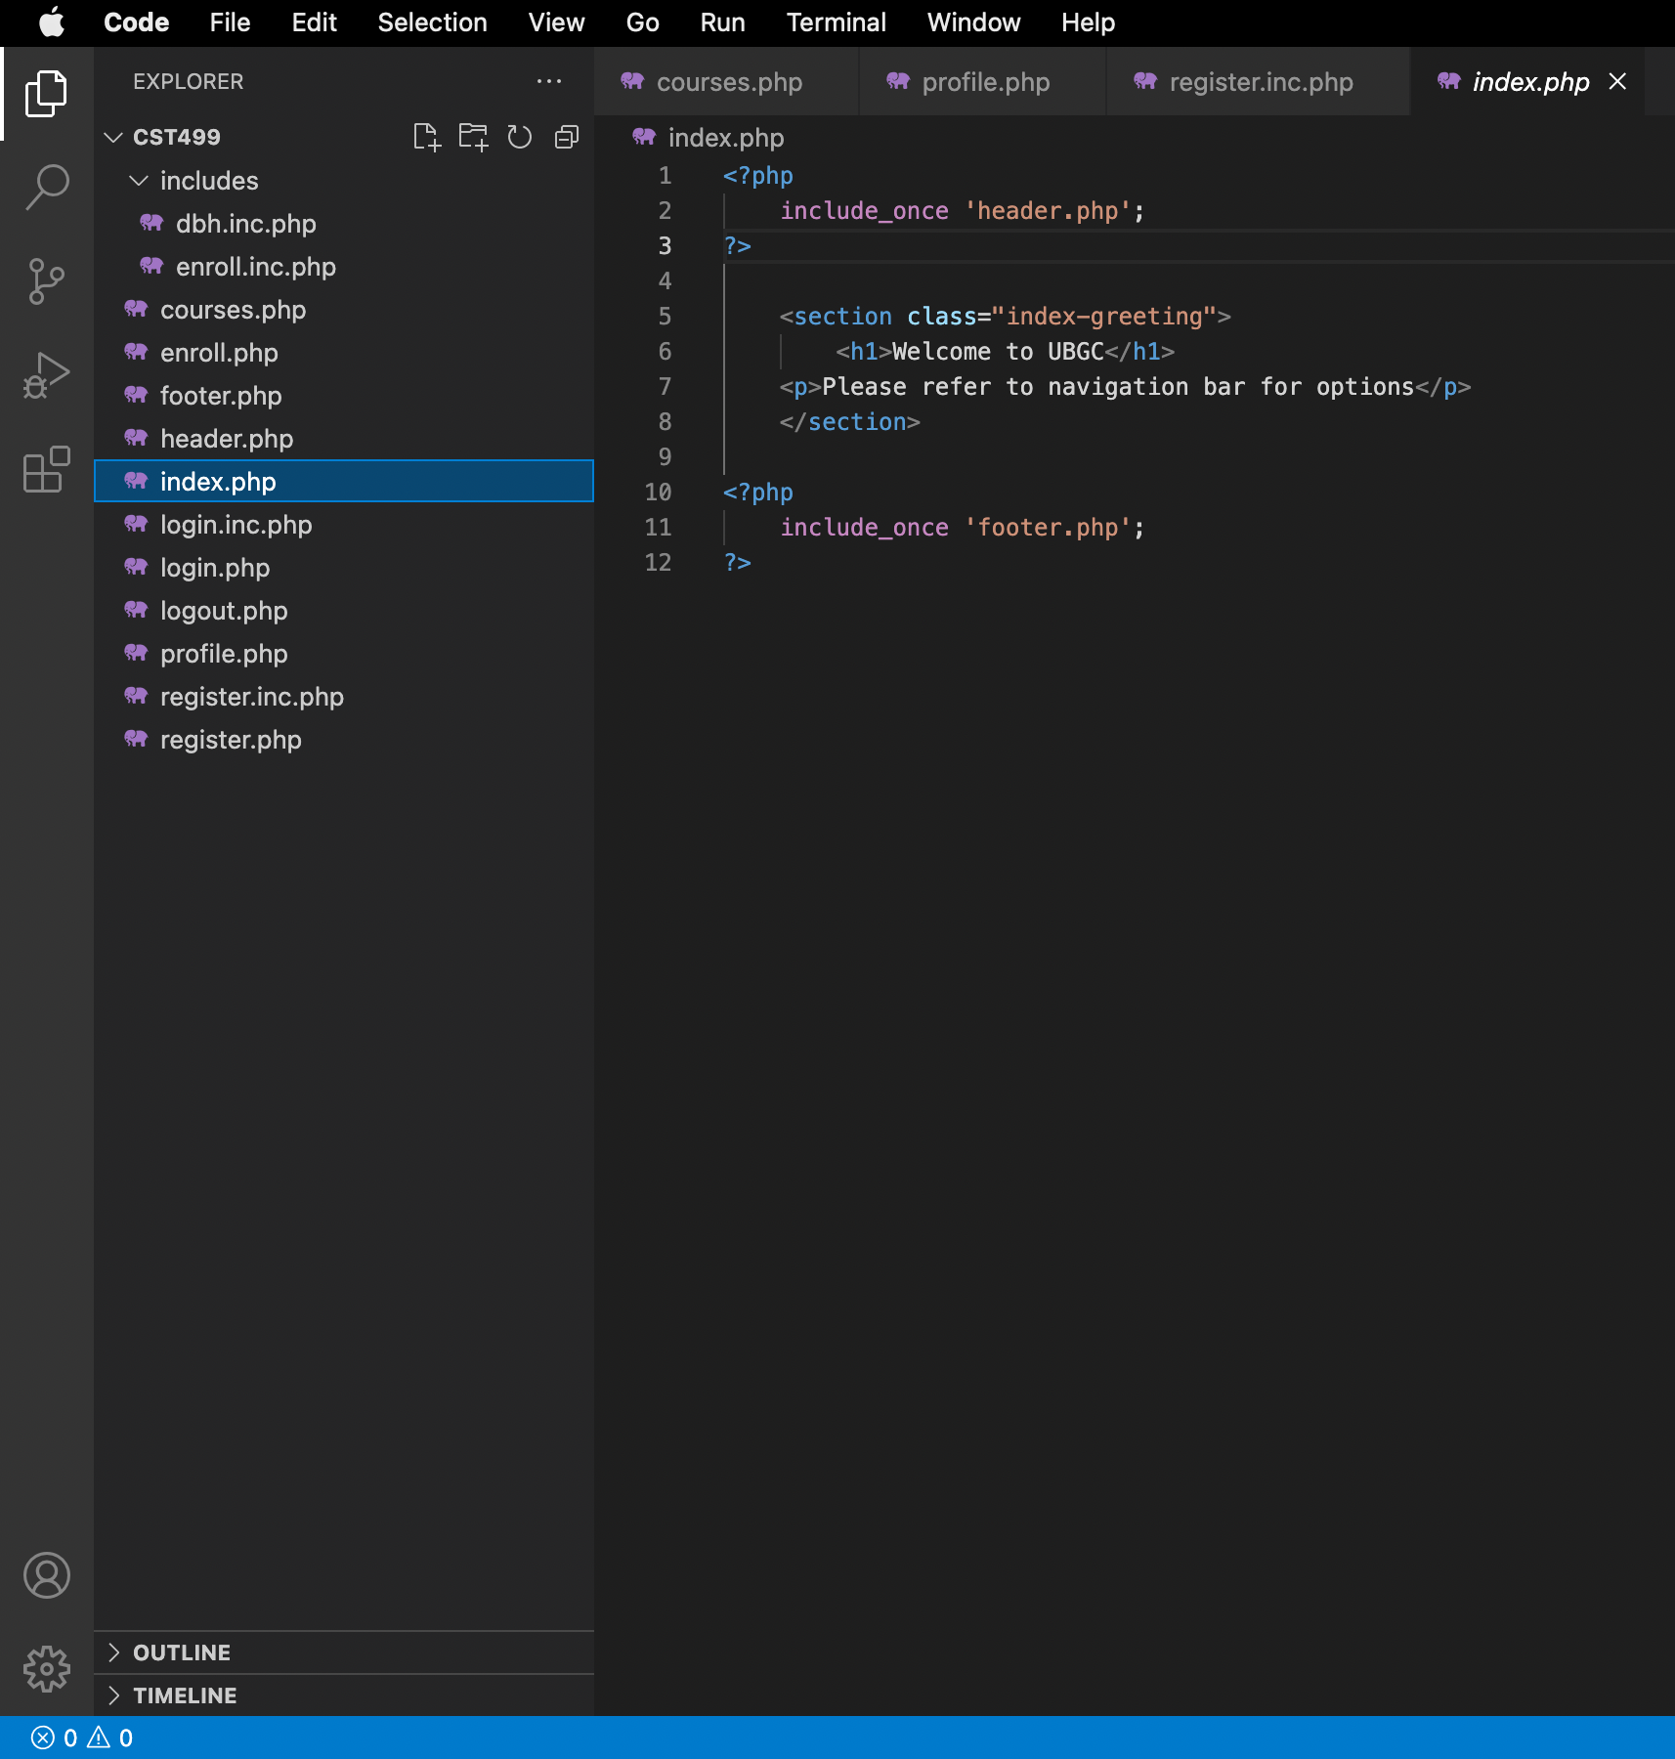
Index: Home Page
z

Slide 4
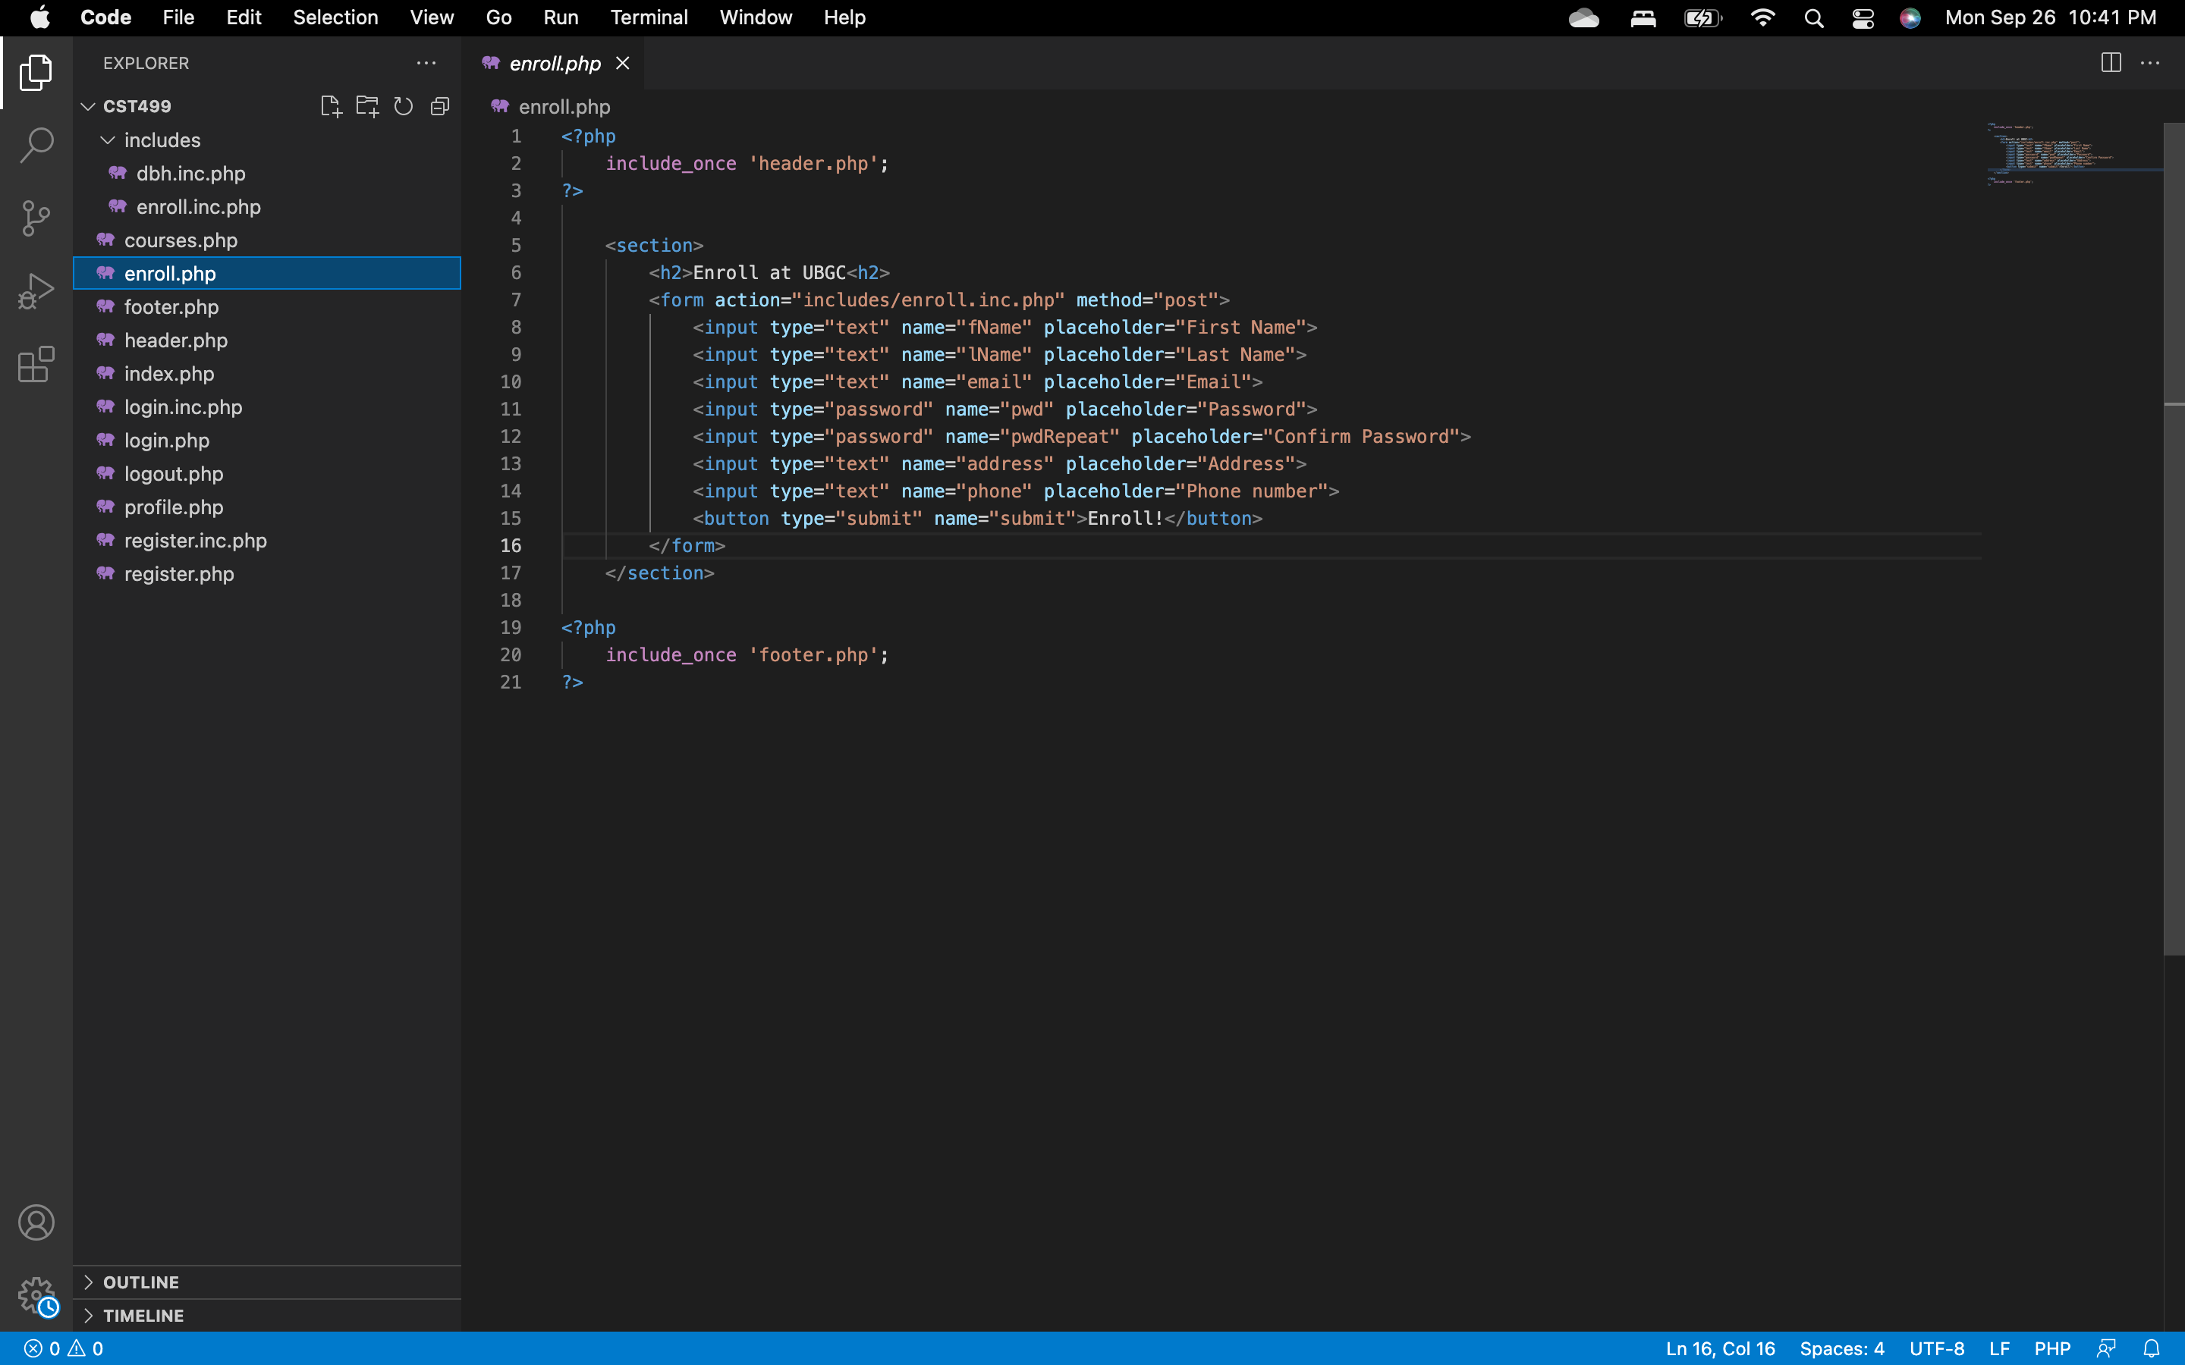
Enroll HTML
z

Slide 5
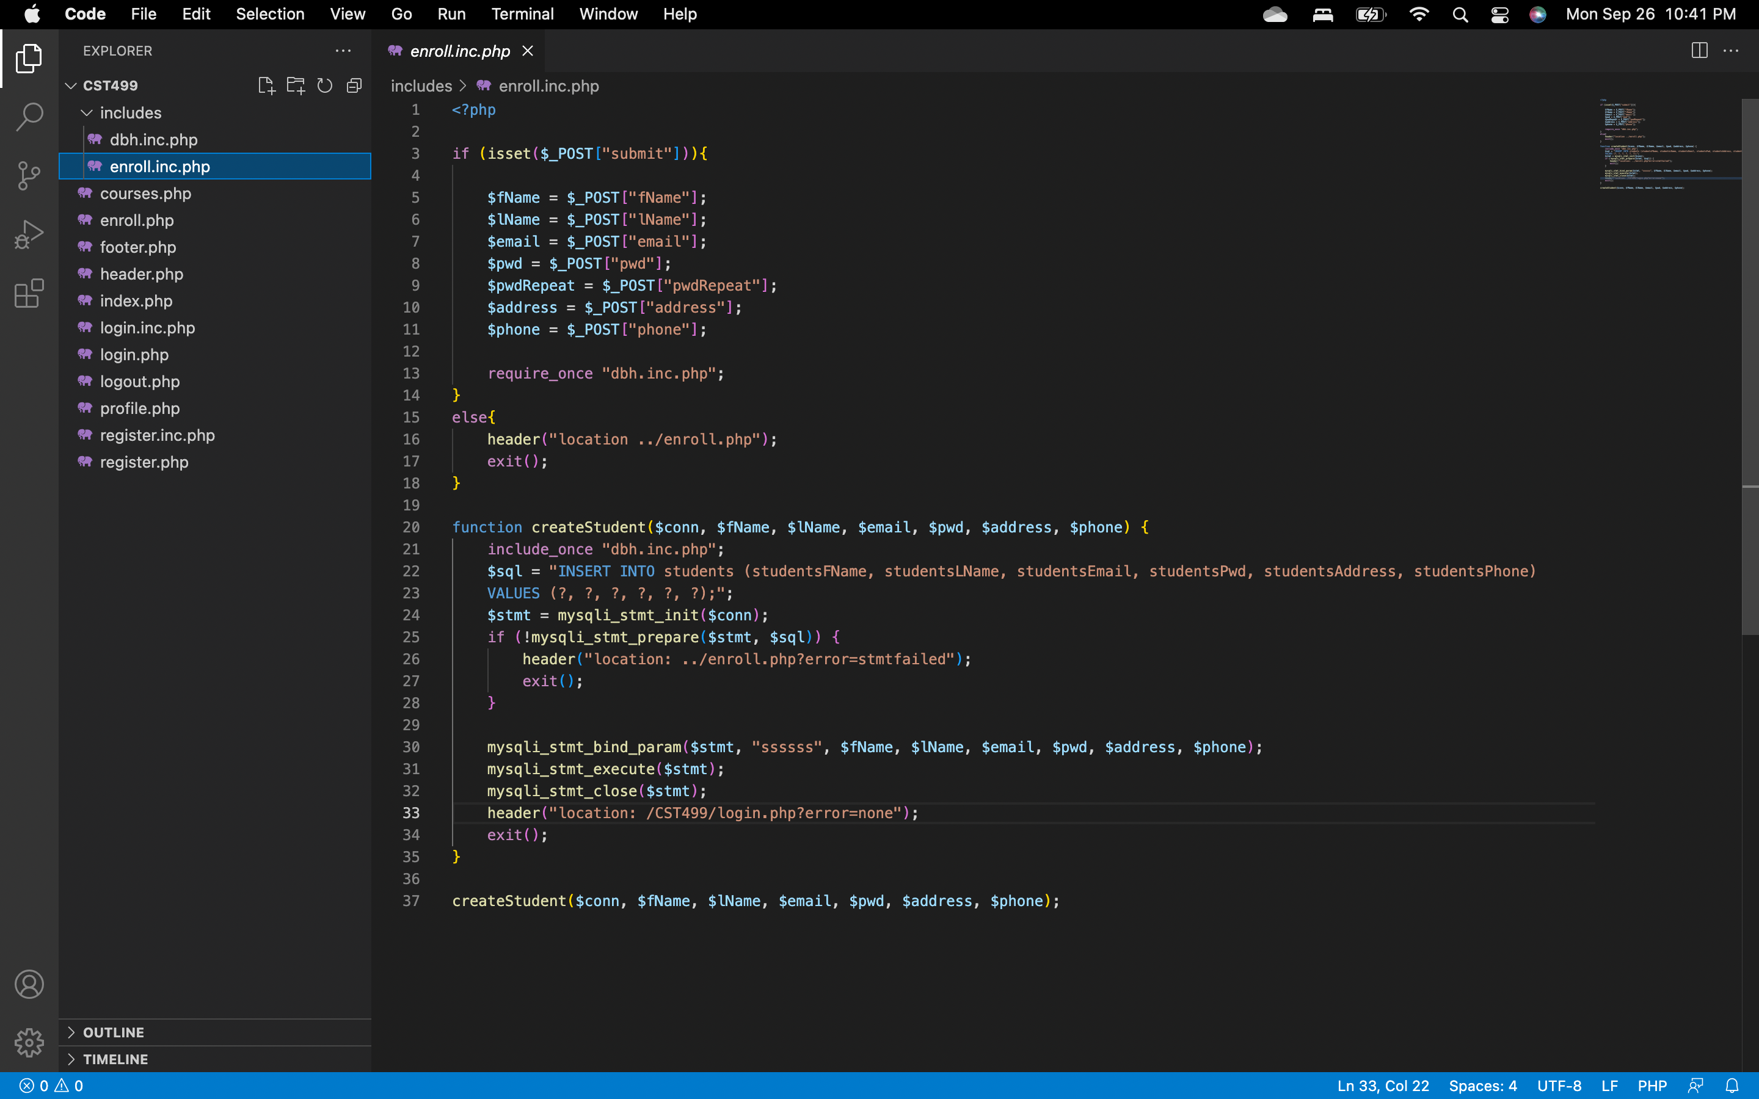
Enroll PHP
z

Slide 6
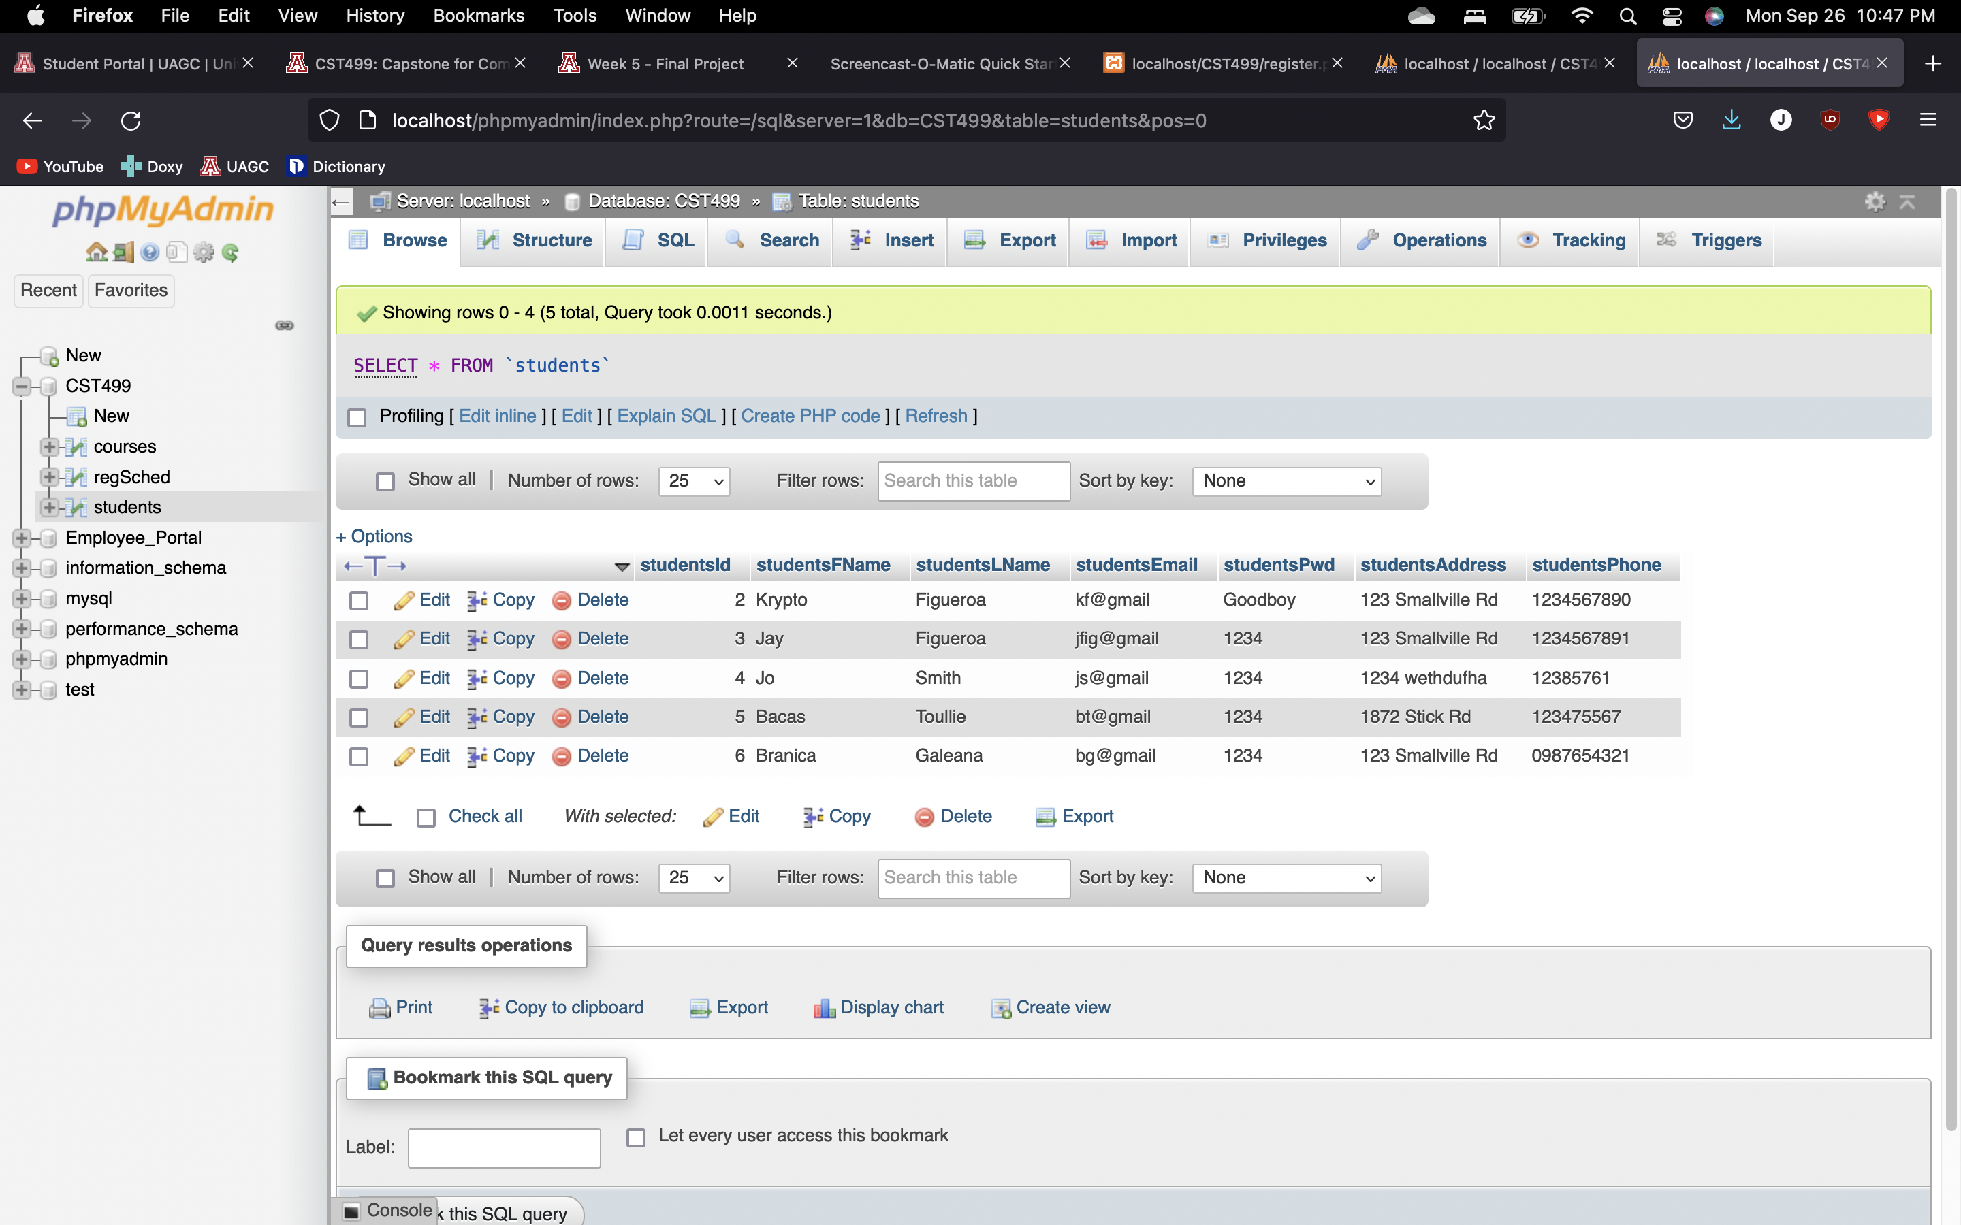
Students Table (Result)
z

Slide 7
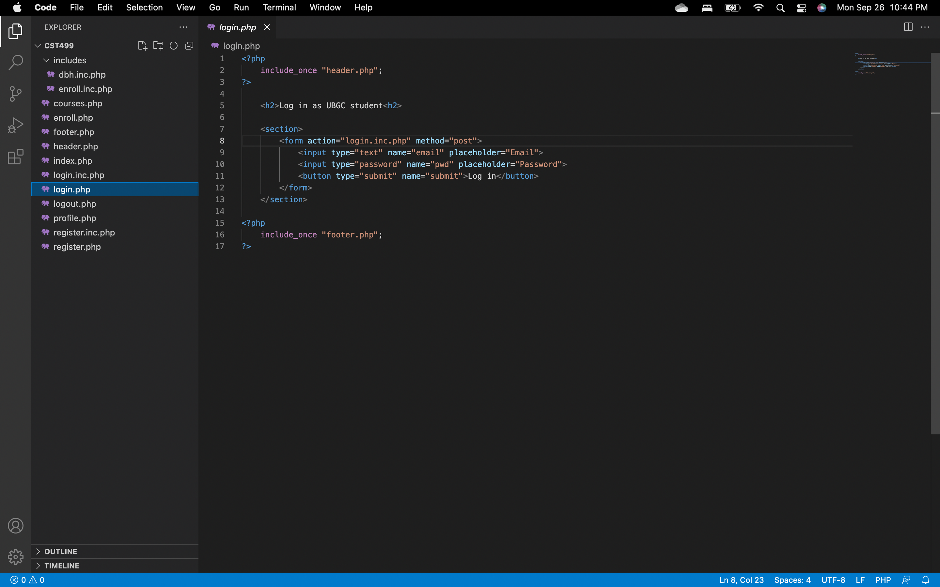
Login HTML
z

Slide 8
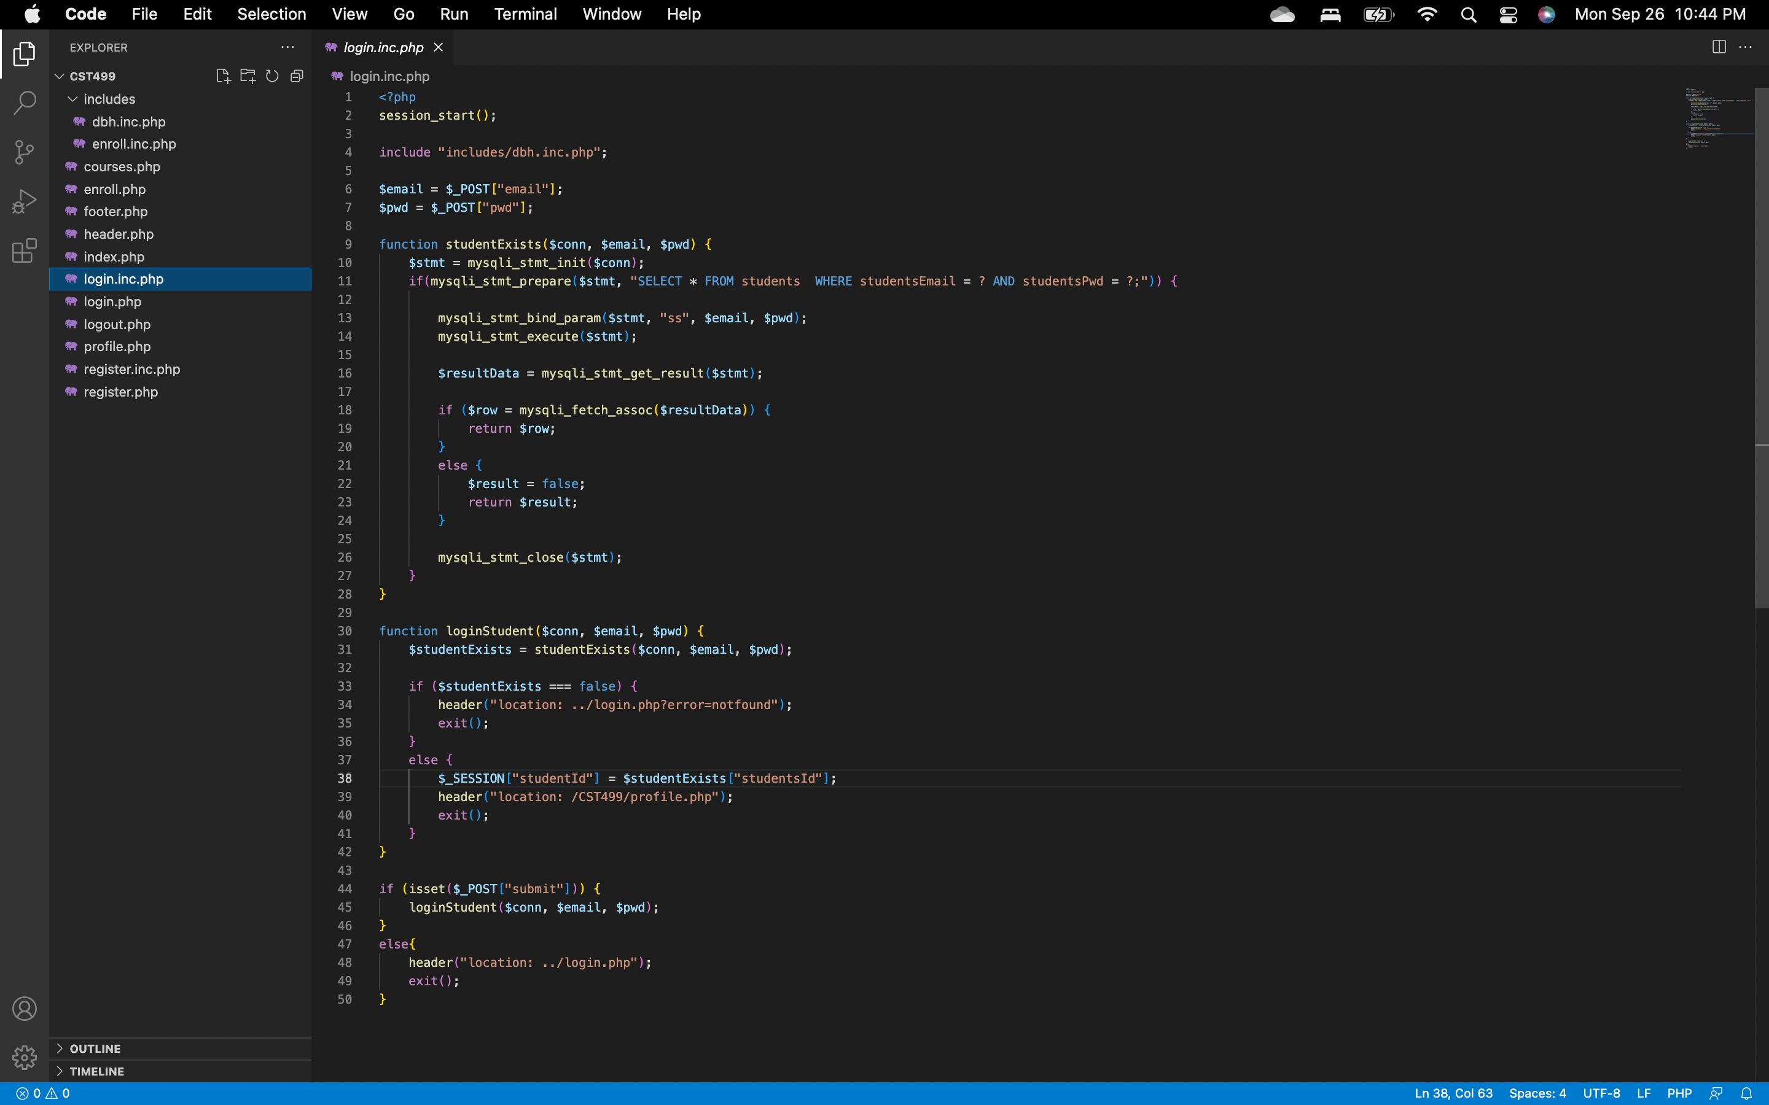
Login PHP
z

Slide 9
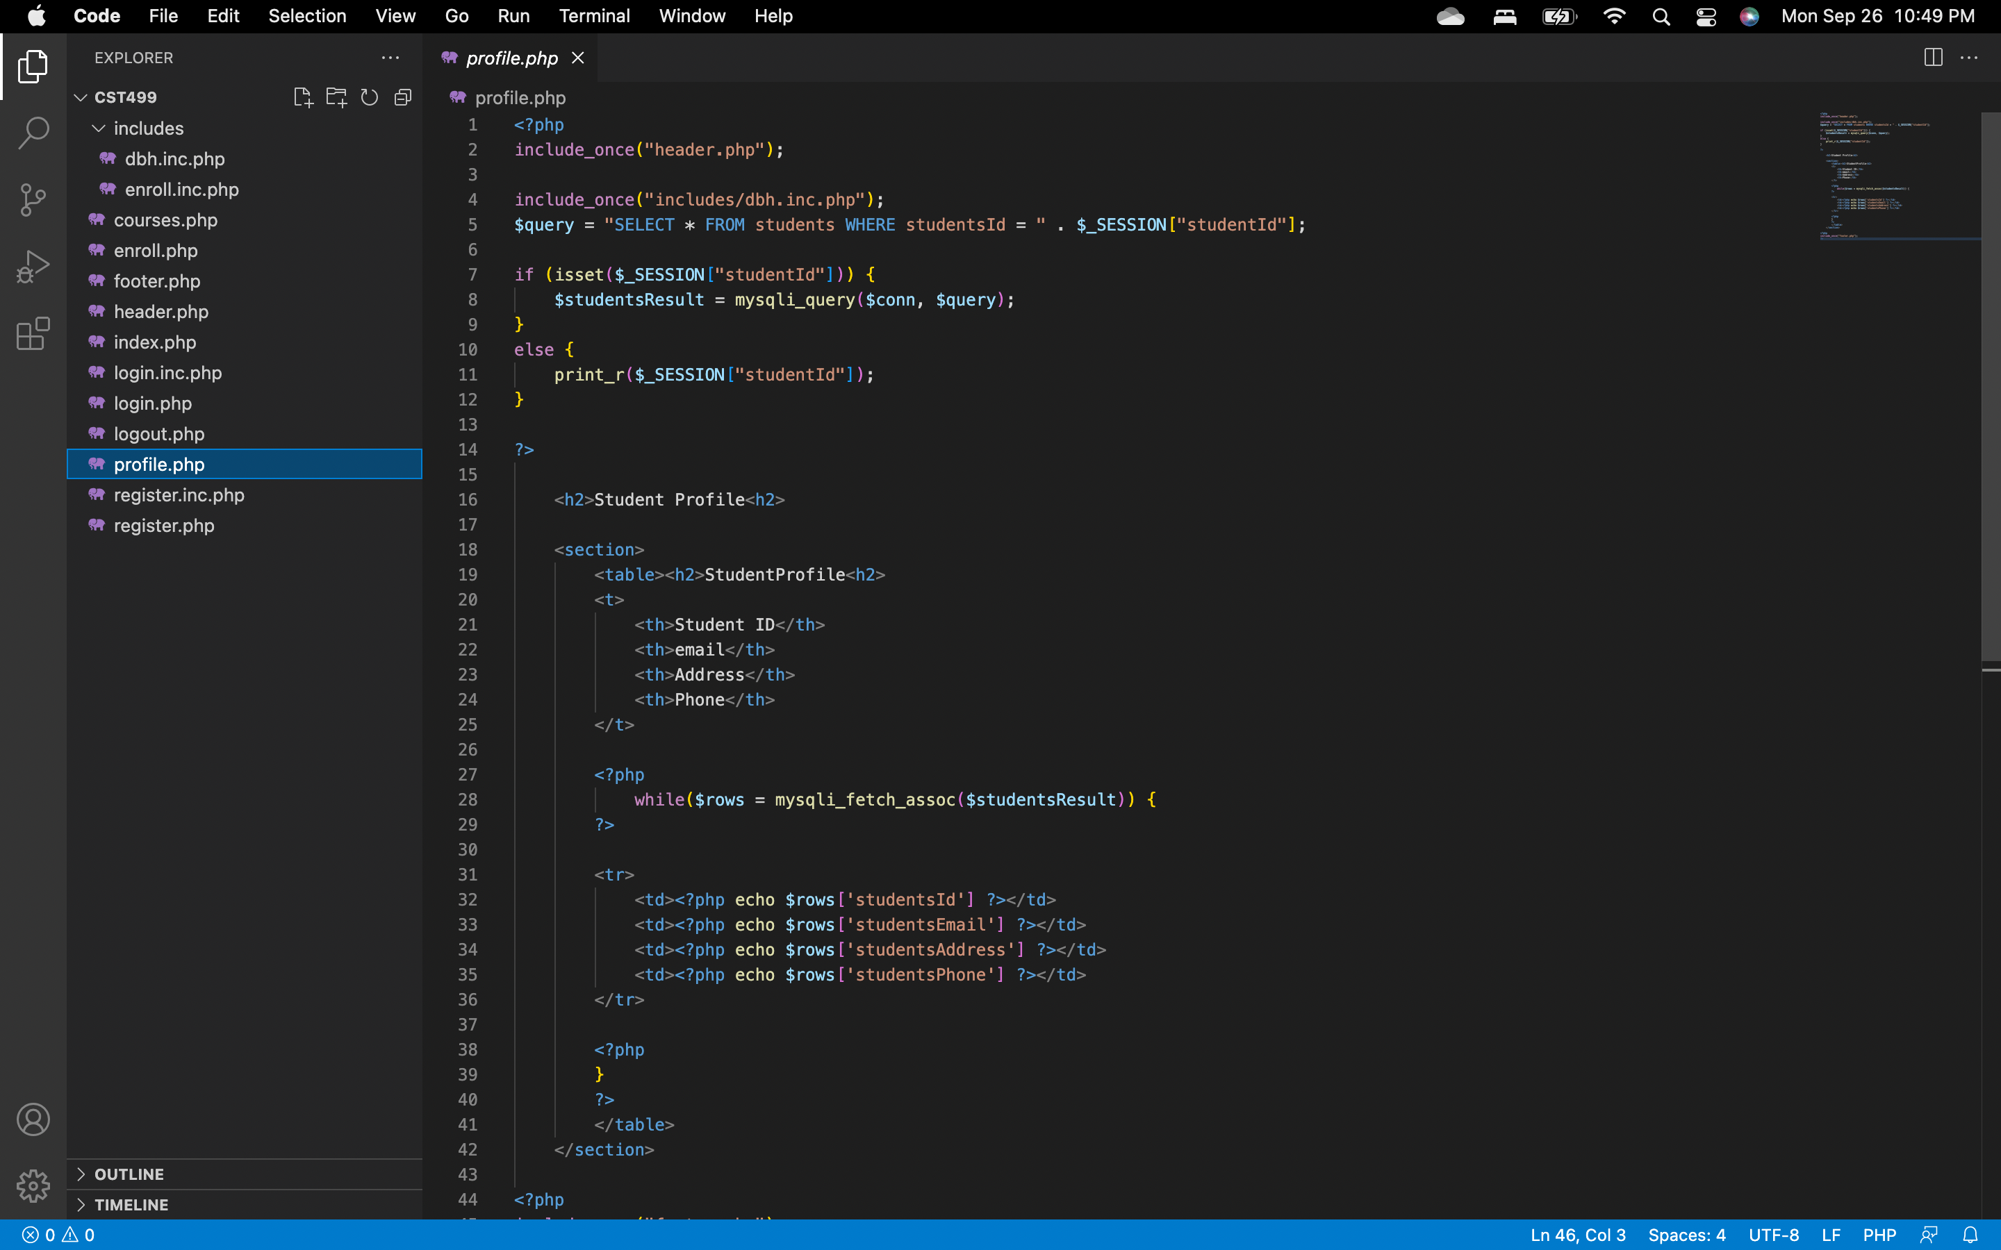
Profile HTML
z

Slide 10
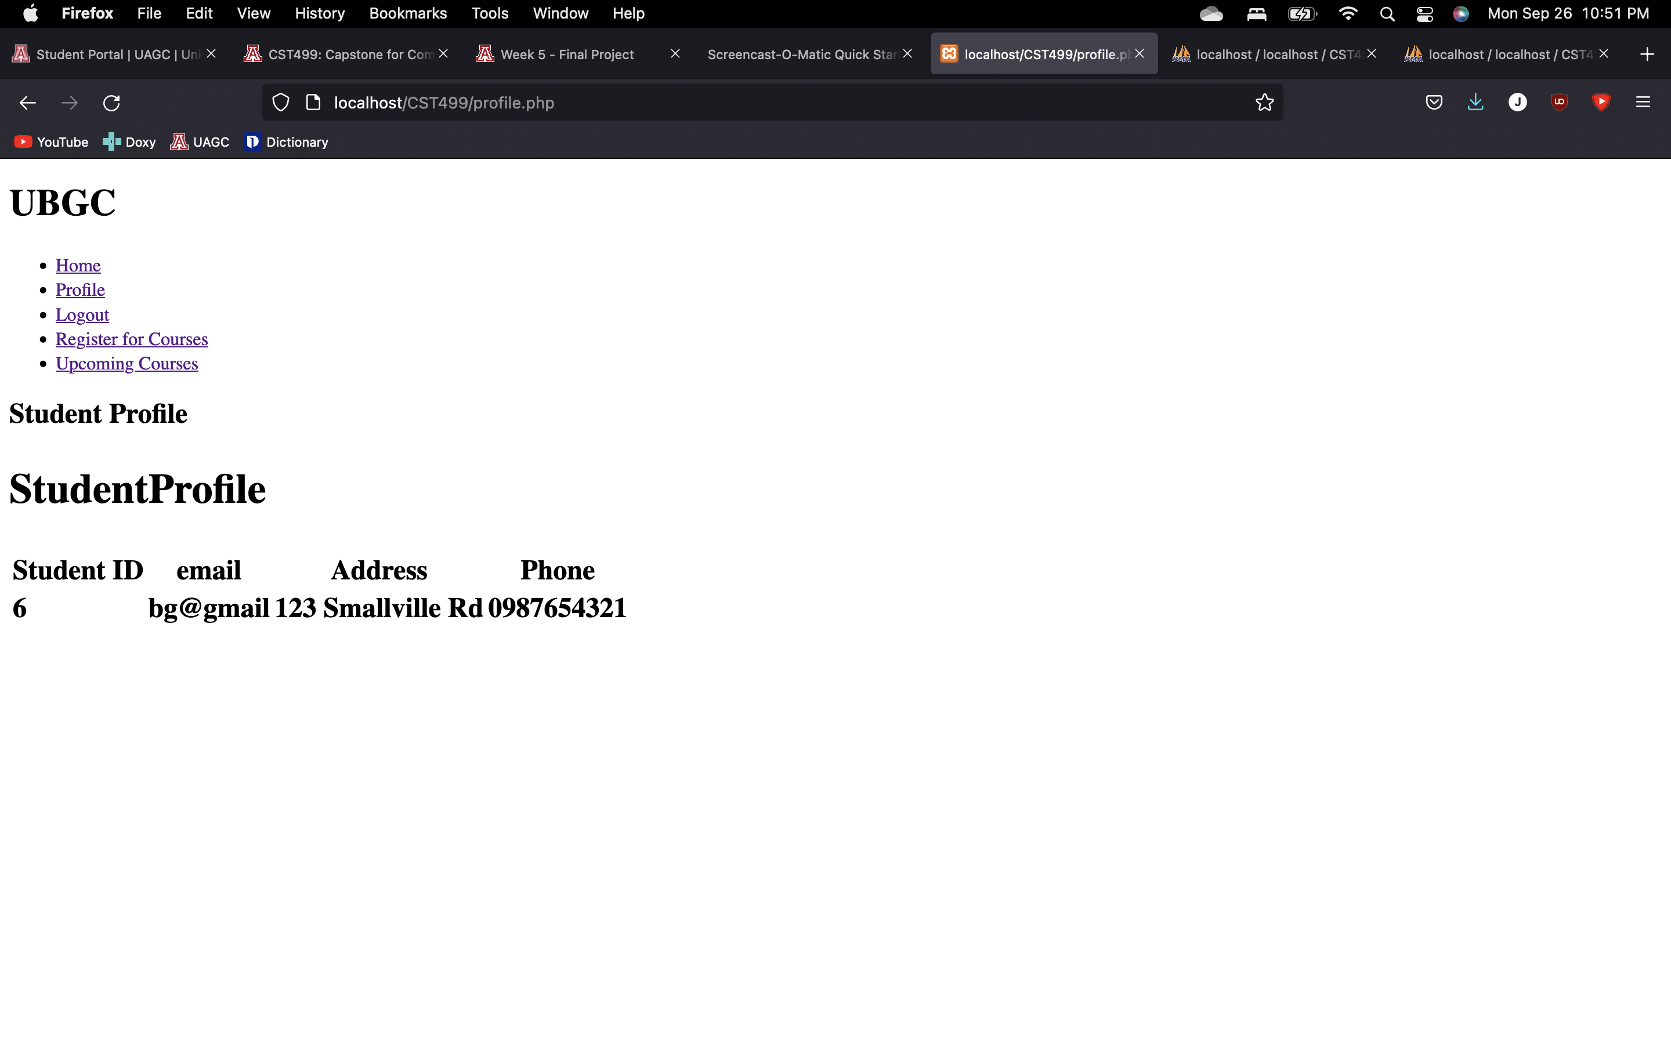
Profile UI (Result)
z

Slide 11
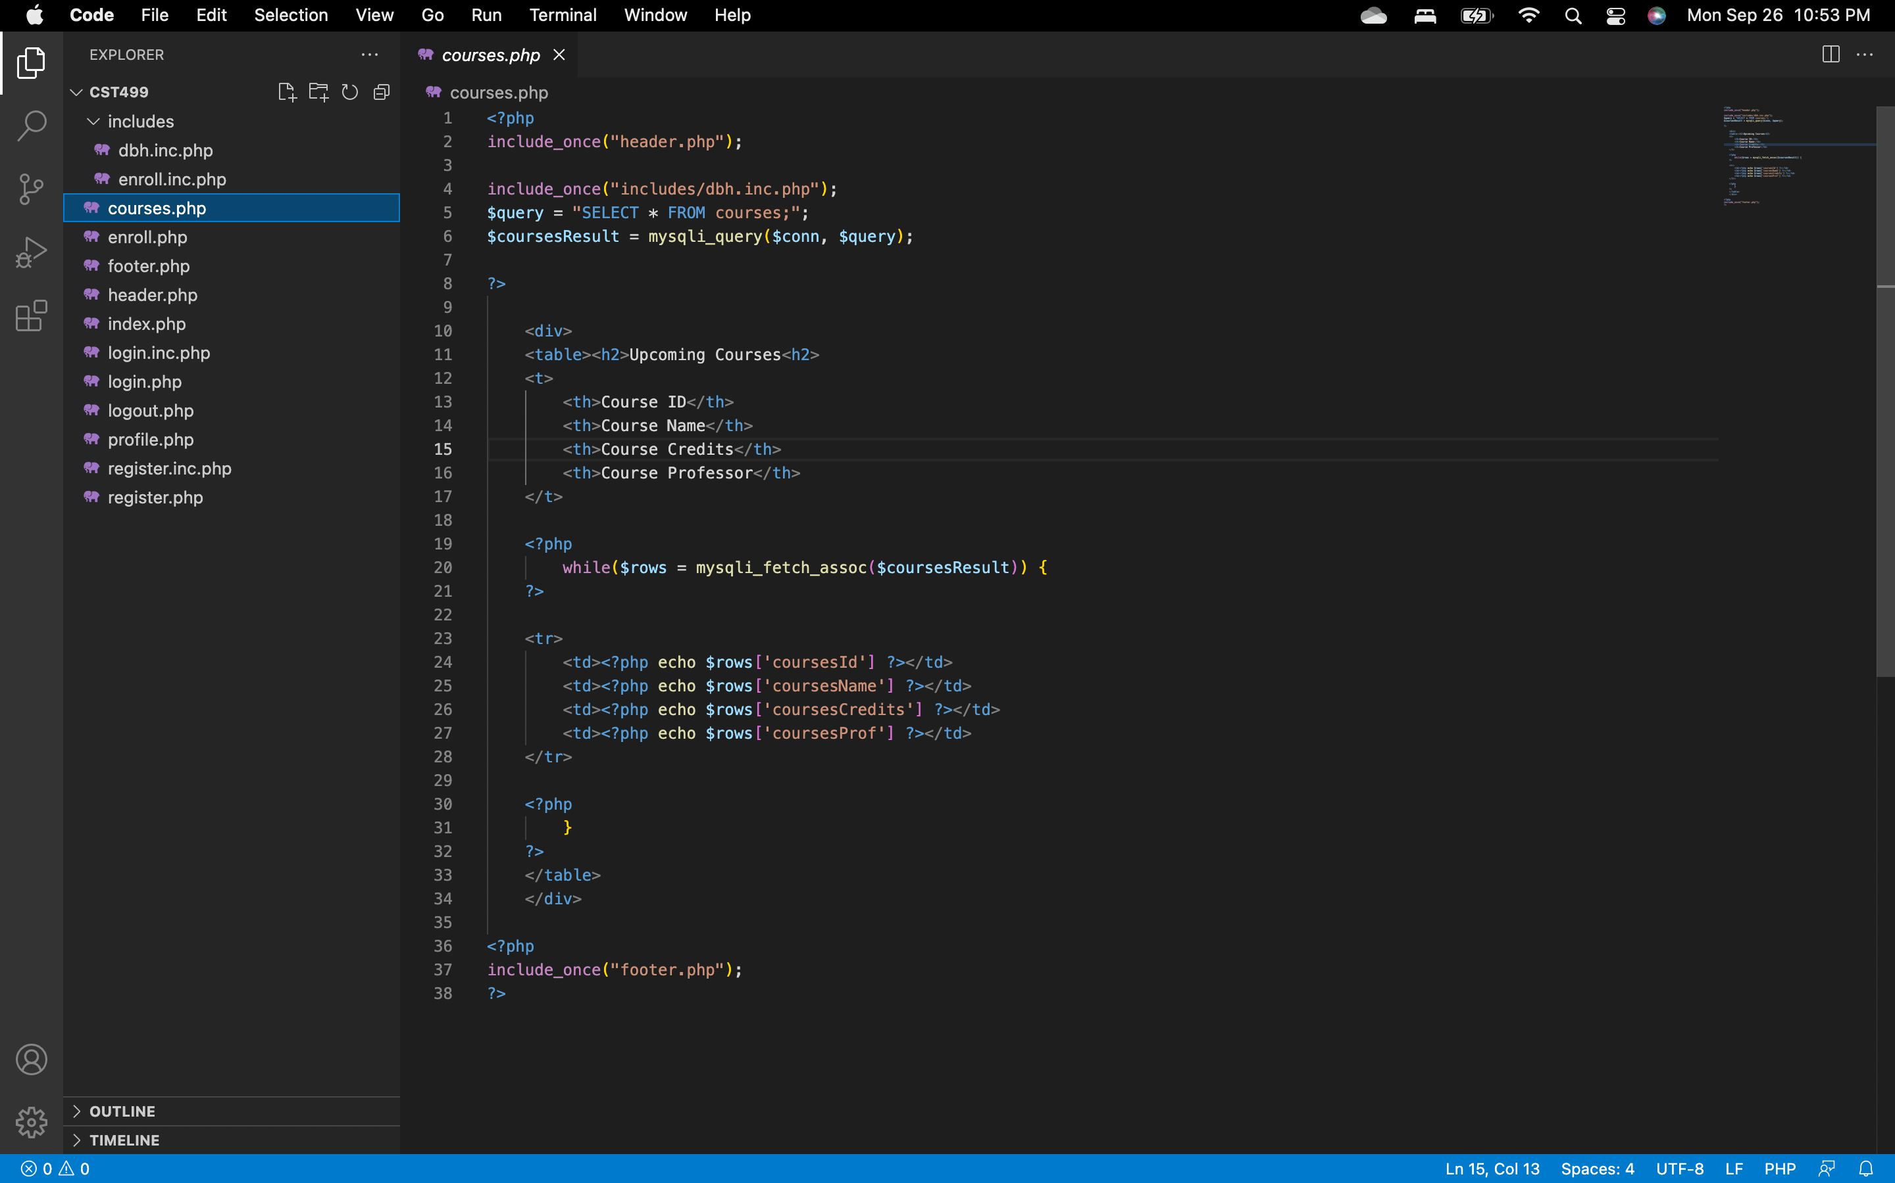
Courses HTML
z

Slide 12
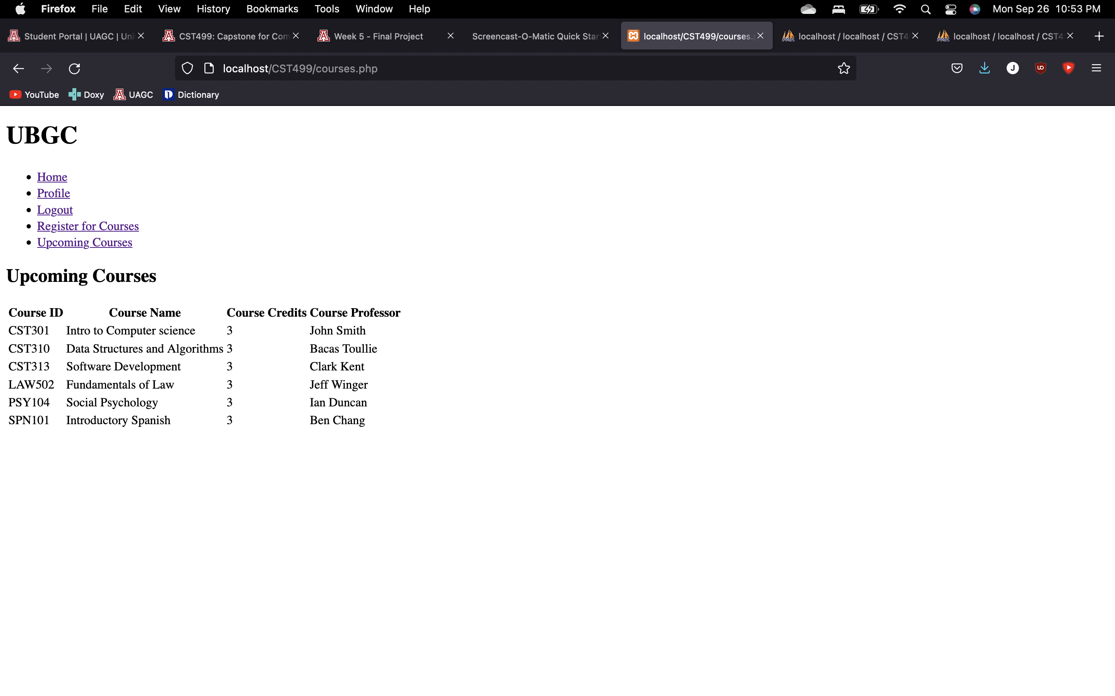
Course Listing (Result)
z

Slide 13
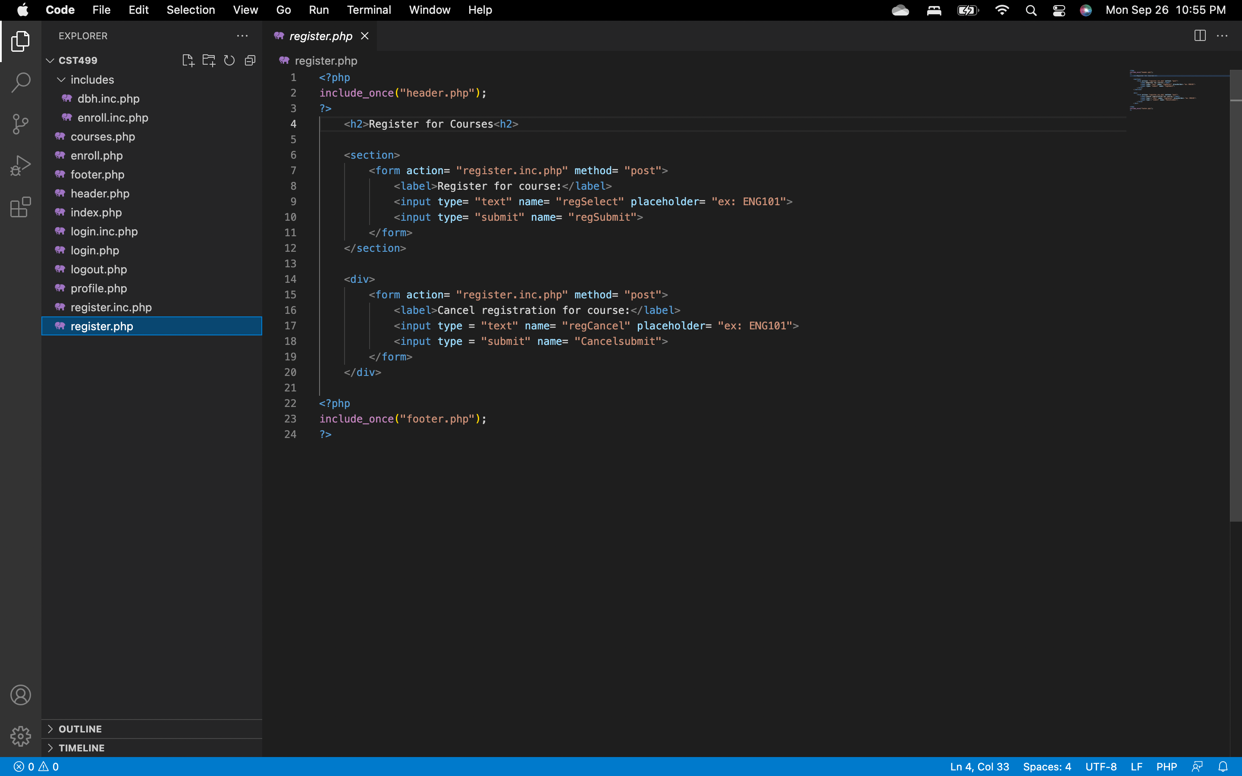
Register HTML
z

Slide 14
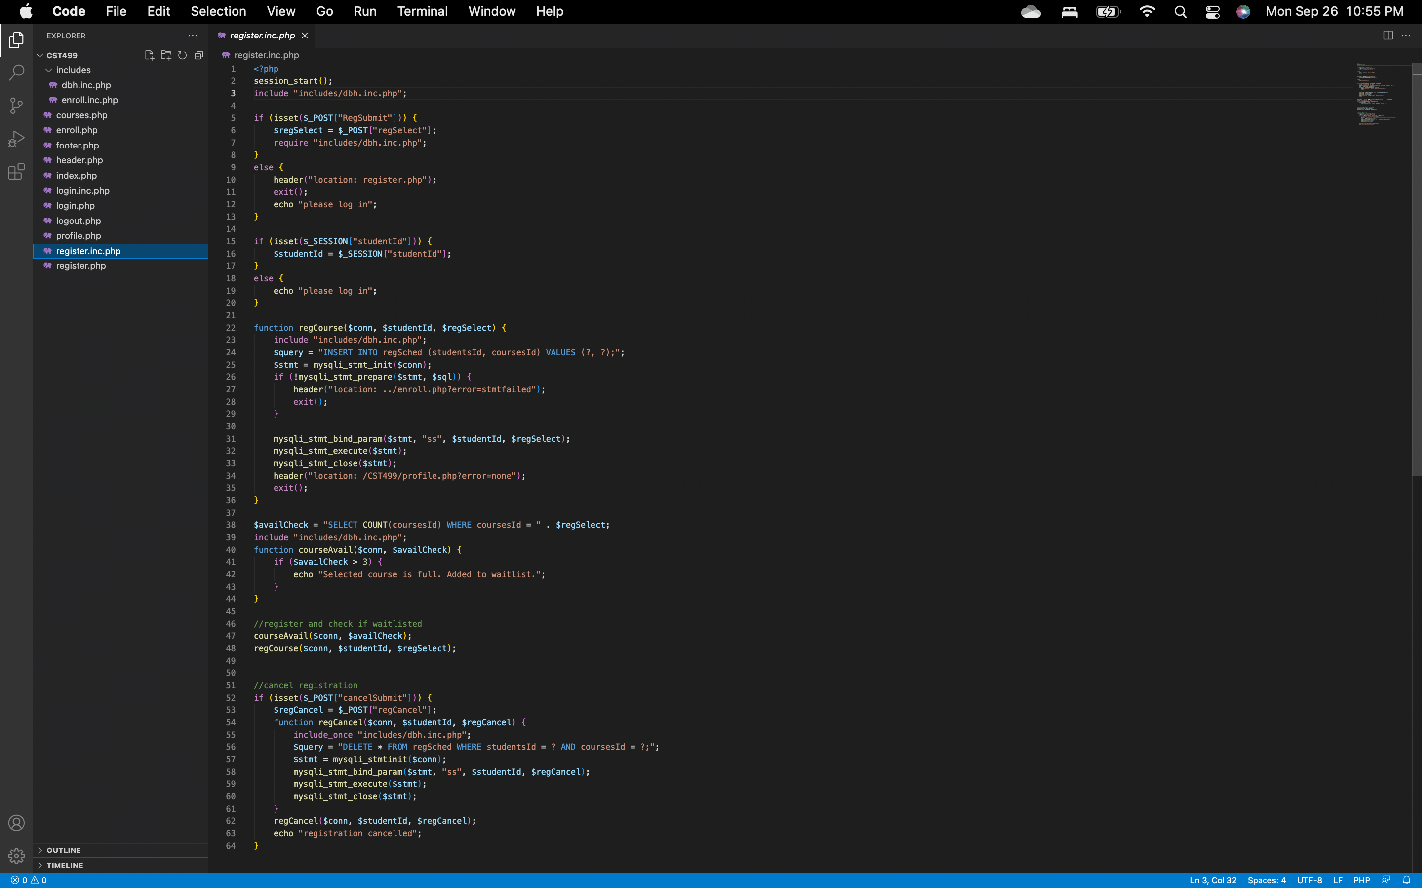
Register PHP
z

Slide 15
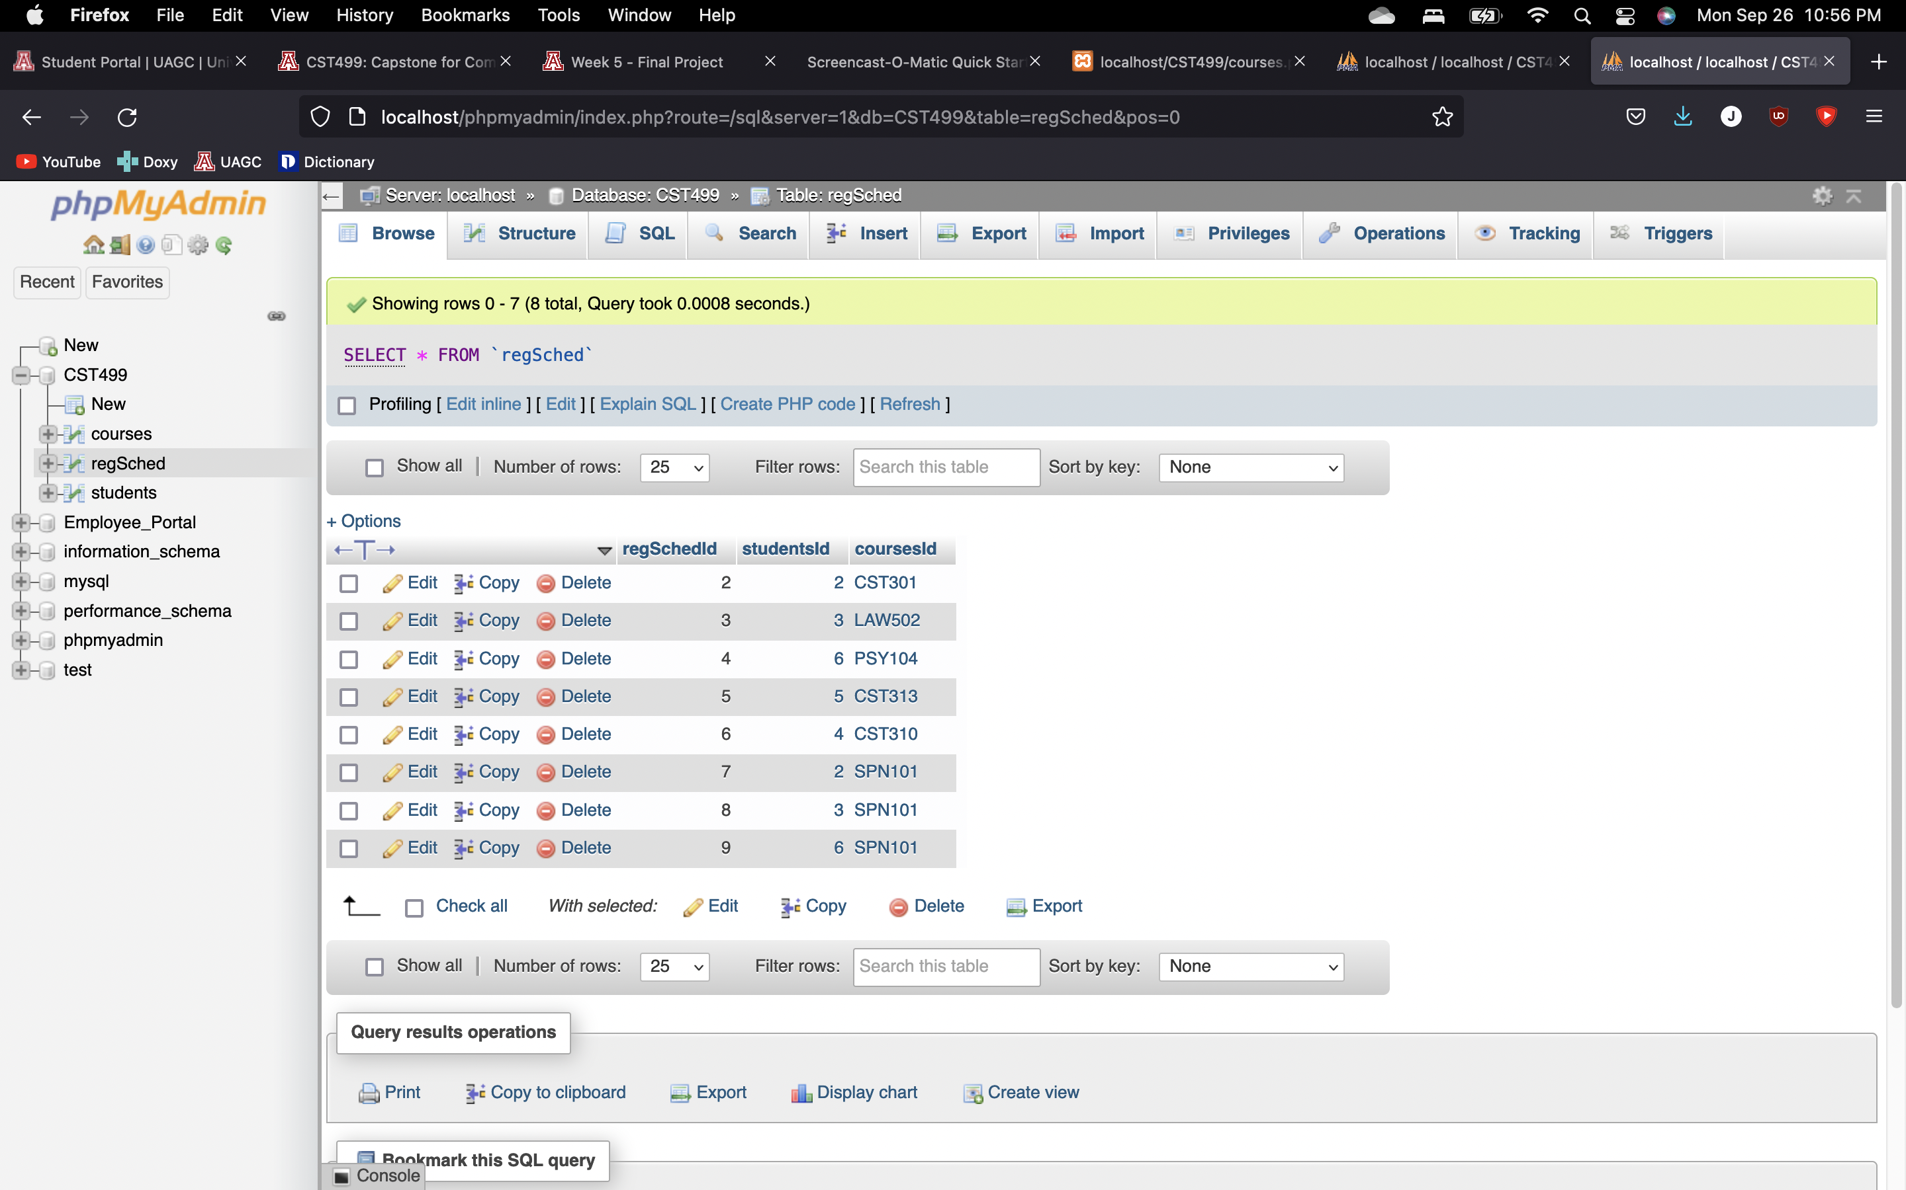
Registration Table (Result)
z

